Slide 1
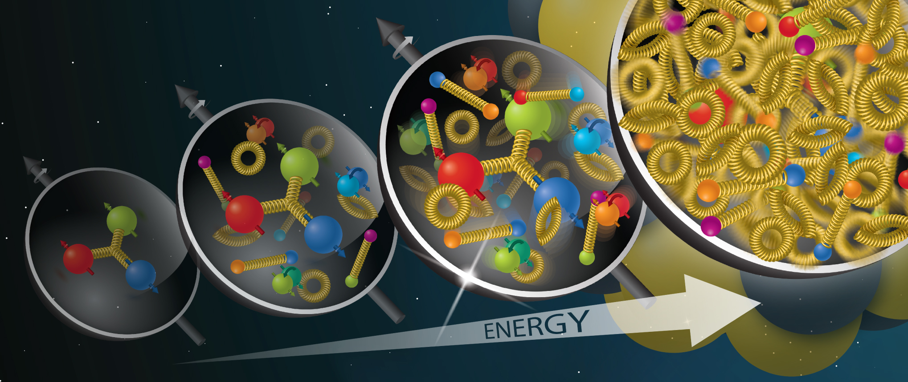
Understanding QCD dynamics through p-Pb collisions at the LHC
Allencris J.R.R.
Supervisor: Prof. Ronan McNulty
Image Credit: “Brookhaven Lab to Lead New 'Saturated Glue' Theory Collaboration“ , Brookhaven National Laboratory, 2022. https://www.bnl.gov/newsroom/news.php?a=120965
Notes:
Brief overview of end goal. Ie. Gluon saturation has not been seen definitively but should manifest in suppressed cross-sections.
1

Slide 2
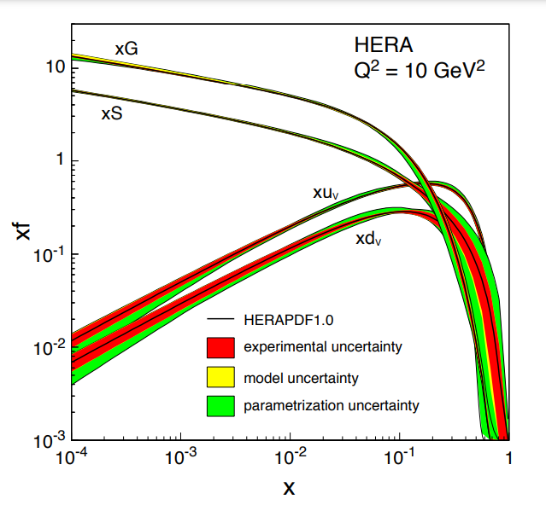
Fig1. Proton parton distribution functions plotted as a function of Bjorken x
(Acardi et al., 2012)

Slide 3
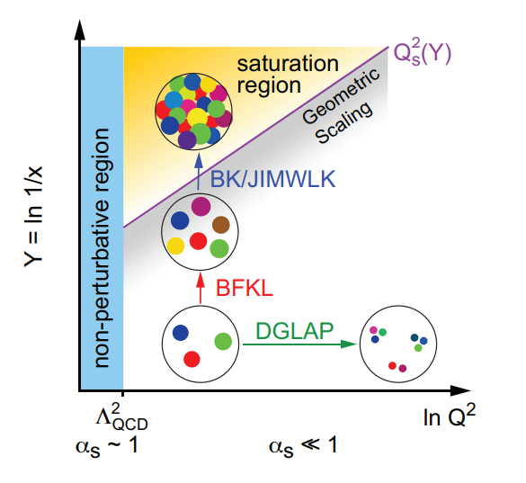
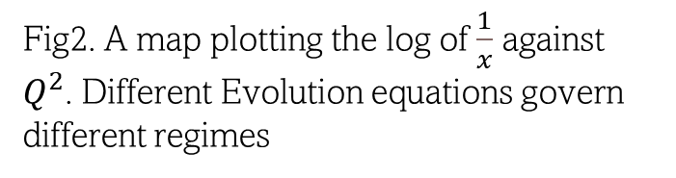
Fig2. A map plotting the log of $\frac{1}{x}$ against $Q^{2}$. Different Evolution equations govern different regimes
(Acardi et al., 2012)

Slide 4
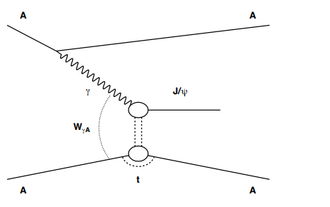
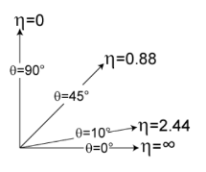

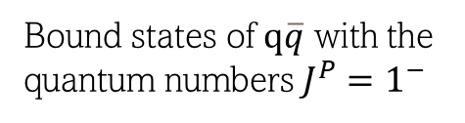

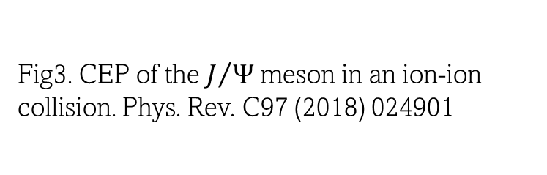
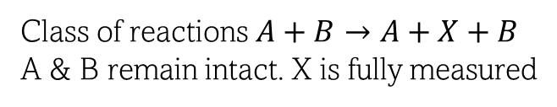
Introduction
Cross-section:
Probability that a given process takes place
Vector Mesons:
Bound states of $q\overline{q}$ with the quantum numbers $J^{P}=1^{−}$
Central Exclusive Production:
Class of reactions $A+B→A+X+B$
A & B remain intact. X is fully measured
Fig3. CEP of the $J/Ψ$ meson in an ion-ion collision. Phys. Rev. C97 (2018) 024901
Rapidity (y) :
Measure of particle angle with respect to beam axis
$y≈η$ for UR
Pseudorapidity ($η$) :
Rapidity but easier to measure
Fig4. Pseudorapidity range
(Albrow et al, 2010)
Notes:
Get people familiar with basic vocab of project. Show them what CEP looks like diagrammatically
4

Slide 5
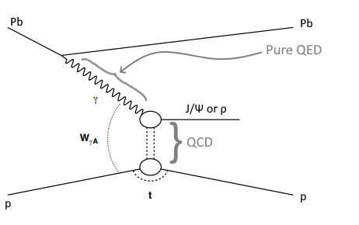
Fig5. The particular process(es) we’re interested in.
Notes:
Describe physical process being used in investigation. CEP produces no junk as the particles don’t interact hadronically. Useful for clean signals and simplified analysis.
5

Slide 6
Overview of Project Goals
Weizsacker-Williams Approximation
Equivalent photon spectrum
$$σ\left(h_{1}+h_{2}→h_{1}⊗V⊗h_{2}\right)=∫dω\frac{n_{h1}\left(ω\right)}{ω}σ_{γh_{2}→V⊗h_{2}}\left(W_{γh_{2}}^{2}\right)+∫dω\frac{n_{h2}\left(ω\right)}{ω}σ_{γh_{1}→V⊗h_{1}}\left(W_{γh_{1}}^{2}\right)$$
Photoproduction cross-section
Color-dipole formalism
(Goncalves et al, 2017)

Slide 7
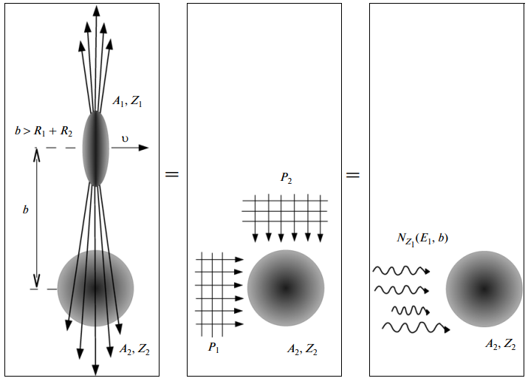

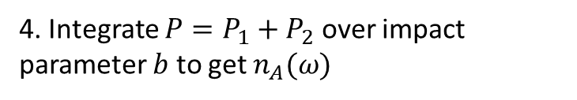



Equivalent Photon Approximation (EPA)
1. Compute E-field of $A_{1}$ in rest frame of $A_{2}$
2. Fourier transform $E\left(t\right)→E(ω)$
3. $P_{1}→E_{2}$ and $P_{2}→E_{1}$
4. Integrate $P=P_{1}+P_{2}$ over impact parameter $b$ to get $n_{A}(ω)$
$$n_{A}\left(ω\right)=\frac{2Z_{A}^{2}α_{EM}}{π}[ζK_{0}\left(ζ\right)K_{1}\left(ζ\right)−\frac{ζ^{2}}{2}(K_{1}^{2}\left(ζ\right)−K_{0}^{2}\left(ζ\right)]$$
Fig6. Diagram showing equivalence of the E-field and a flux of photons
(Pshenichnov, 2011)
(Fermi, 1924)
(Williams, 1935)

Slide 8
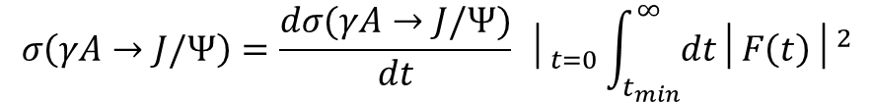

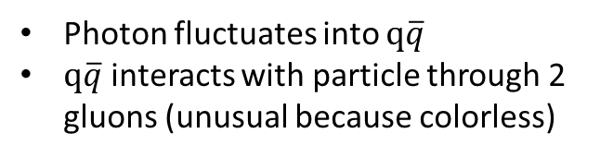
Photoproduction cross-section
Photon fluctuates into $q\overline{q}$
$q\overline{q}$ interacts with particle through 2 gluons (unusual because colorless)
$\frac{dσ(γA→J/Ψ)}{dt} │_{t=0}=\frac{π^{3}Γ_{ee}M_{J/Ψ}^{3}}{48α}\frac{α_{S}^{2}{\overline{(Q}}^{2})}{{\overline{Q}}^{8}}×{\left[xG_{A}\left(x, {\overline{Q}}^{2}\right)\right]}^{2}$
Light V
Heavy V
$$σ\left(γA→J/Ψ\right)=\frac{dσ(γA→J/Ψ)}{dt} │_{t=0}\int_{t_{min}}^{∞}{dt│F\left(t\right)│^{2}}$$
Regge Theory
pQCD
Then creates/ moves off as V

Slide 9
References
[1] A. Accardi et al. Electron Ion Collider: The Next QCD Frontier - Understanding the glue that binds us all. 2012. DOI: 10. 48550/ARXIV.1212.1701. URL: https://arxiv.org/abs/1212.1701.
[2] M.G. Albrow, T.D. Coughlin, and J.R. Forshaw. “Central exclusive particle production at high energy hadron colliders”. In: Progress in Particle and Nuclear Physics 65.2 (2010), pp. 149–184. DOI: 10.1016/j.ppnp.2010.06.001. URL: https: //doi.org/10.1016%2Fj.ppnp.2010.06.001.
[3] Carlos A. Bertulani, Spencer R. Klein, and Joakim Nystrand. “PHYSICS OF ULTRA-PERIPHERAL NUCLEAR COLLISIONS”. In: Annual Review of Nuclear and Particle Science 55.1 (2005), pp. 271–310. DOI: 10.1146/annurev.nucl. 55.090704.151526. URL: https://doi.org/10.1146%2Fannurev.nucl.55.090704.151526.
[4] Enrico Fermi. “On the Theory of Collisions between Atoms and Electrically Charged Particles”. In: Electromagnetic Probes of Fundamental Physics. WORLD SCIENTIFIC, 2003. DOI: 10.1142/9789812704214_0026. URL: https://doi.org/ 10.1142%2F9789812704214_0026.
[5] V. P. Gonc¸ alves and C. A. Bertulani. “Peripheral heavy ion collisions as a probe of the nuclear gluon distribution”. In: Physical Review C 65.5 (2002). DOI: 10.1103/physrevc.65.054905. URL: https://doi.org/10.1103%2Fphysrevc. 65.054905.
[6] V. P. Gonc¸alves and M. V. T. Machado. “Nuclear exclusive vector meson photoproduction”. In: The European Physical Journal C 38.3 (2004), pp. 319–328. DOI: 10.1140/epjc/s2004-02044-7. URL: https://doi.org/10.1140%2Fepjc% 2Fs2004-02044-7.
[7] V. P. Gonc¸alves et al. “Color dipole predictions for the exclusive vector meson photoproduction in pp/pP b/P bP b collisions at run 2 LHC energies”. In: Physical Review D 96.9 (2017). DOI: 10 . 1103 / physrevd . 96 . 094027. URL: https : //doi.org/10.1103%2Fphysrevd.96.094027.
[8] Spencer R. Klein et al. “STARlight: A Monte Carlo simulation program for ultra-peripheral collisions of relativistic ions”. In: Computer Physics Communications 212 (2017), pp. 258–268. DOI: 10 . 1016 / j . cpc . 2016 . 10 . 016. URL: https : //doi.org/10.1016%2Fj.cpc.2016.10.016.
[9] I. A. Pshenichnov. “Electromagnetic excitation and fragmentation of ultrarelativistic nuclei”. In: Phys. Part. Nucl. 42 (2011), pp. 215–250. DOI: 10.1134/S1063779611020067.
[10] E. J. Williams. “Correlation of certain collision problems with radiation theory”. In: Kong. Dan. Vid. Sel. Mat. Fys. Med. 13N4.4 (1935), pp. 1–50.

